Slide 1
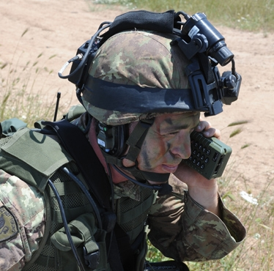
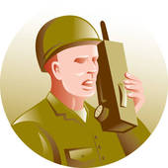
VeVa GROP Praktijkoefendagen (POD)
Lesson – Radio communications in English

Slide 2
Today’s lesson will be about radio communications
Why?
How to report to your commander in the field
PVB
+
Military future

Slide 3
The basics:
Checking the radio net
Informing ‘’Romeo’’ of possible threats

Slide 4
How do you check your radio’s / the radio net?
Romeo: Net here Romeo, radio check over.
Alpha: -Romeo here Alpha, roger over.
Bravo: -Romeo here Bravo, roger over.
ALWAYS ALPHABETICALLY
Charlie: -Romeo here Charlie, roger over.
Delta: -Romeo here Delta, roger over.
Romeo: Net here Romeo, out.

Slide 5
Report to your commander using the ‘’ W+H’’ model
5 x W+H
Who = ‘’call sign’’
What = ‘’hoofdgroep nummer’’ ‘’subgroep letter’’ ‘’grootte’’ ‘’vorm’’ ‘’kleur’’ ‘’opschrift’’
Where = ‘’coördinaat’’ OF zo duidelijk mogelijke beschrijving.
When = datum-tijdgroep
How = contactpersoon benaderingsroute en markering

Slide 6
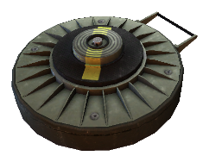
Report to your commander using the ‘’4 W+H’’ model
5 x W+H | Example
Who = ‘’call sign’’
Alpha: Romeo, here Alpha, urgent message over
What = ‘’hoofdgroep nummer’’ ‘’subgroep letter’’ ‘’grootte’’ ‘’vorm’’ ‘’kleur’’ ‘’opschrift’’
Alpha: Here Alpha, Anti – tank mine, 4F,
40 centimeters, green, no markings.
Where = ‘’coördinaat’’ OF zo duidelijk mogelijke beschrijving.
Alpha: Location is 31U GT 03802580
When = datum-tijdgroep
Alpha: time is 270900ANOV15
How = contactpersoon benaderingsroute en markering
Alpha: Alpha on location, Approach from south,
marked with red-white ribbon.

Slide 7


Slide 8

YOUR TURN

Slide 9
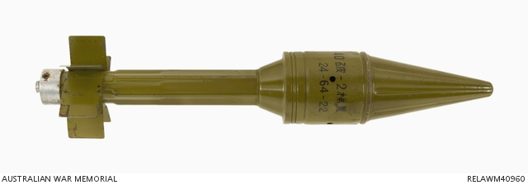
What if we would find this object in the school’s parking lot?

Slide 10
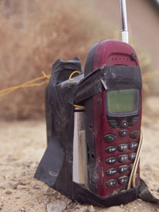
What if we would find this in this classroom?

Slide 11
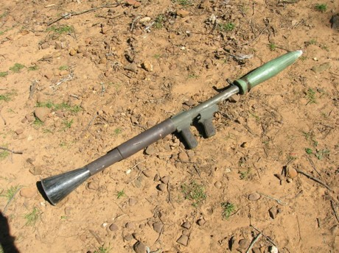
What if we would find this at the reception?

